Slide 1
The Transport Layer
Chapter 6

Slide 2
Transport Service
Upper Layer Services
Transport Service Primitives
Berkeley Sockets
Example of Socket Programming:
Internet File Server

Slide 3
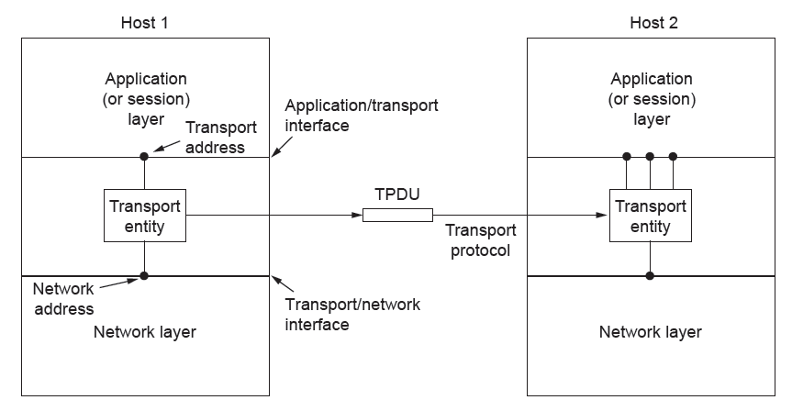
Services Provided to the Upper Layers
The network, transport, and application layers

Slide 4
Services Provided to the Upper Layers
Qualitative distinction between layers 1 through 4 and layer(s) above 4
The bottom four layers can be seen as the transport service provider, whereas the upper layer(s) are the transport service user
It forms the major boundary between the provider and user
of the reliable data transmission service

Slide 5
Transport Service Primitives (1)
To allow users to access the transport service, the transport layer must provide some operations to application programs, that is, a transport service interface
Each transport service has its own interface
The connection-oriented transport service, in contrast, is reliable. Of course, real networks are not error-free, but that is precisely the purpose of the transport layer—to provide a reliable service on top of an unreliable network
As an example, consider two processes on a single machine connected by a pipe in UNIX (or any other interprocess communication facility). They assume the connection between them is 100% perfect. They do not want to know about acknowledgements, lost packets, congestion, or anything at all like that.
The connection-oriented transport service is all about—hiding the imperfections of the network service so that user processes can just assume the existence of an error-free bit stream even when they are on different machines.
The transport layer can also provide unreliable (datagram) service

Slide 6
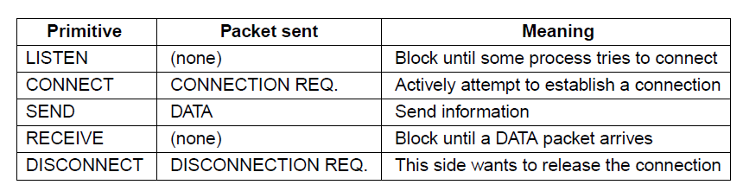
Transport Service Primitives (2)
A second difference between the network service and transport service is
whom the services are intended for
Very few users write their own transport entities, and thus few users or programs ever see the bare network service. In contrast, many programs (and thus programmers wiritng socket applications) see the transport primitives
The primitives for a simple transport service

Slide 7
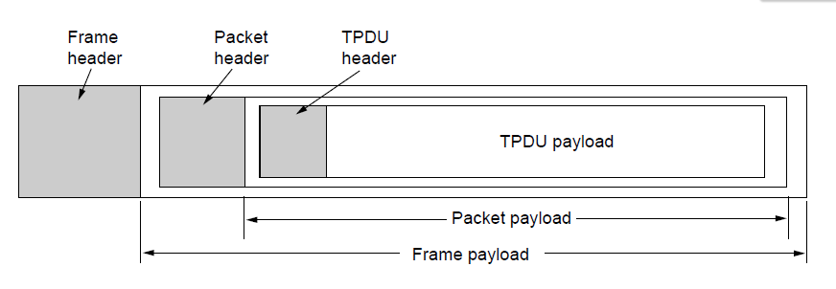
Transport Service Primitives (3)
Nesting of TPDUs, packets, and frames.

Slide 8
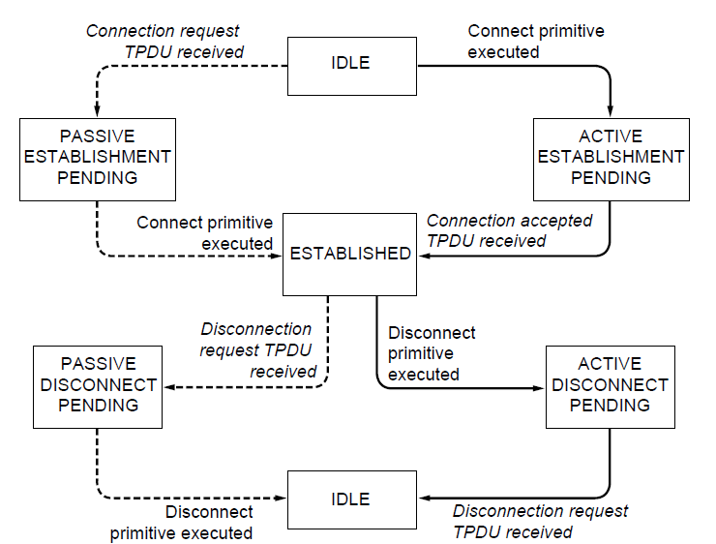
Connection Establishment
A state diagram for a simple connection management scheme. Transitions labeled in italics are caused by packet arrivals. The solid lines show the client’s state sequence. The dashed lines show the server’s state sequence.

Slide 9
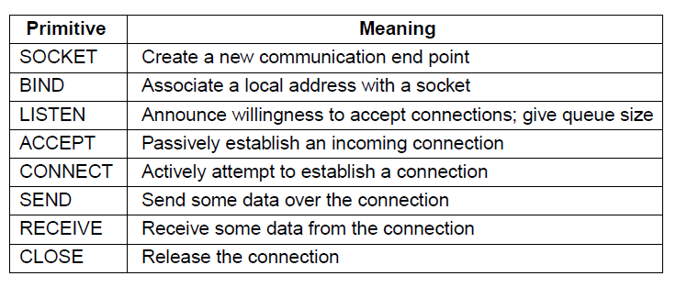
Berkeley Sockets (2)
The socket primitives for TCP

Slide 10
Transport Service Primitives (1)
The first four primitives in the list are executed in that order by servers.
The SOCKET primitive creates a new endpoint and allocates table space for it within the transport entity. The parameters of the call specify the addressing format to be used, the type of service desired (e.g., reliable byte stream), and the protocol
Newly created sockets are assigned network addresses with BIND primitive

Slide 11
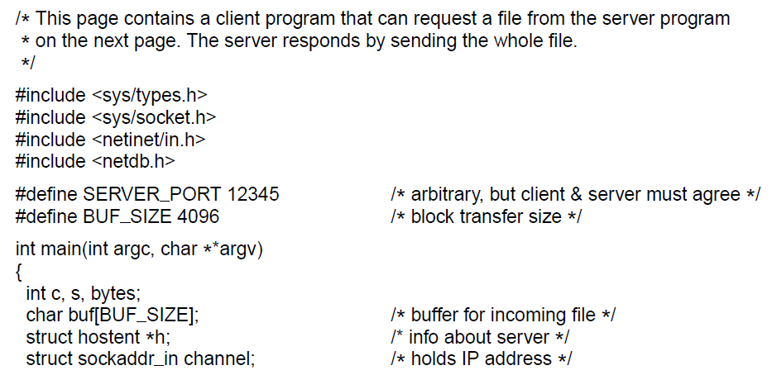
Example of Socket Programming:
An Internet File Server (1)
. . .
Client code using sockets

Slide 12
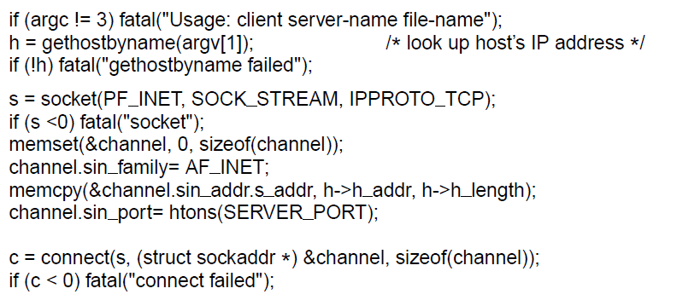
Example of Socket Programming:
An Internet File Server (2)
. . .
. . .
Client code using sockets

Slide 13
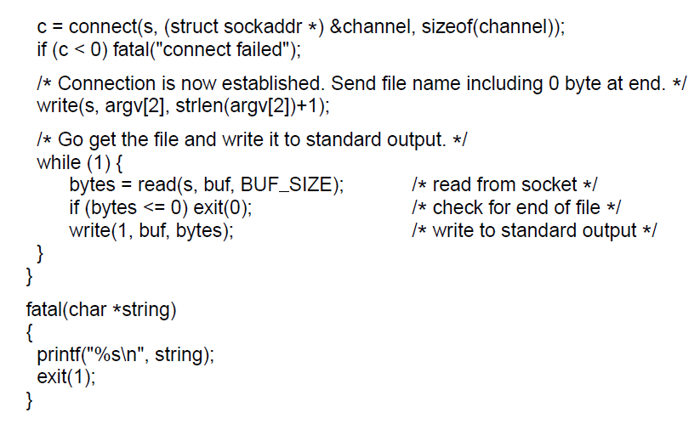
Example of Socket Programming:
An Internet File Server (3)
. . .
Client code using sockets

Slide 14
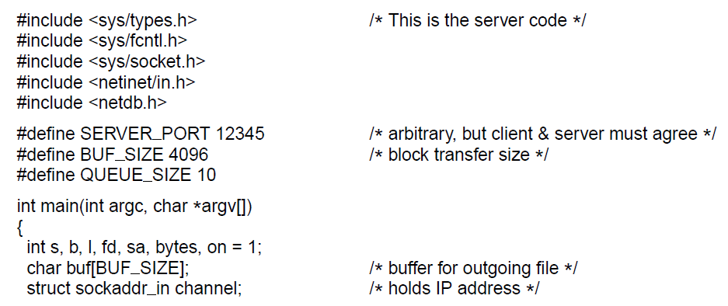
Example of Socket Programming:
An Internet File Server (4)
. . .
Server code

Slide 15
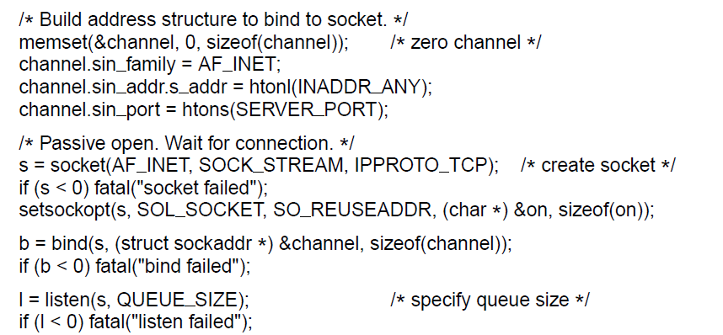
Example of Socket Programming:
An Internet File Server (5)
. . .
. . .
Server code

Slide 16
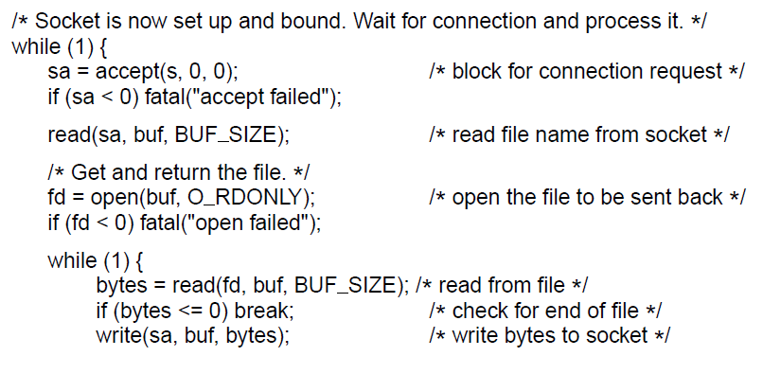
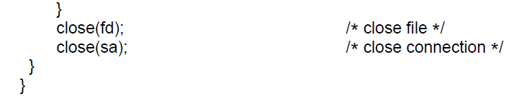
Example of Socket Programming:
An Internet File Server (6)
. . .
Server code

Slide 17
Elements of Transport Protocols (1)
Addressing
Connection establishment
Connection release
Error control and flow control
Multiplexing
Crash recovery

Slide 18
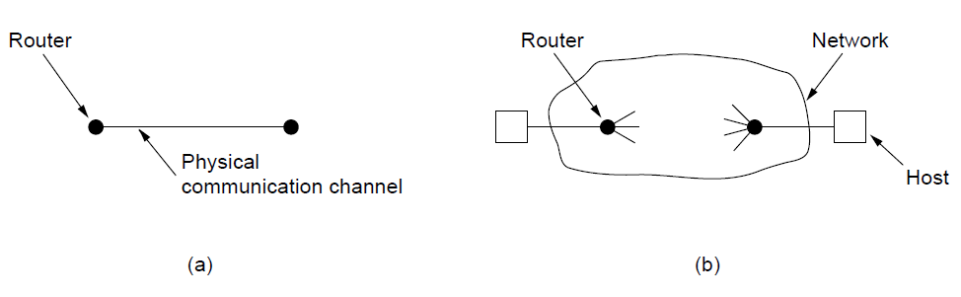
Elements of Transport Protocols (2)
The process of establishing a connection over the wire is simple
The potential existence of storage capacity in the network
Buffering and flow control are needed in both layers, but the presence of a large and varying number of connections with fluctuating bandwidth as the connections compete with each other may require a different approach than we used in the data link layer.
Environment of the data link layer. (b) Environment of the transport layer.

Slide 19
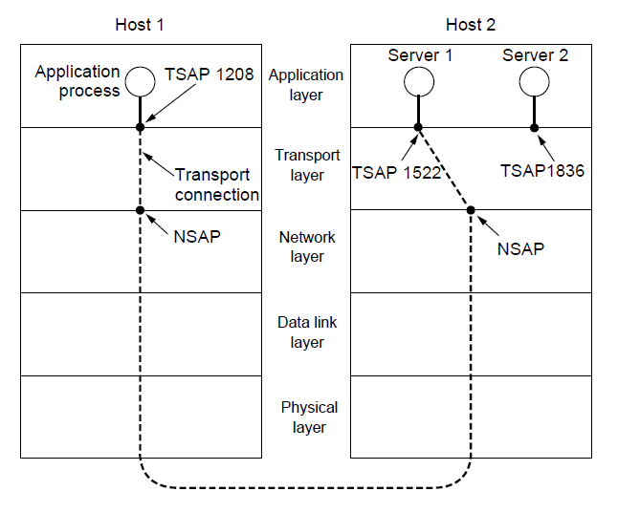
Addressing (1)
TSAPs, NSAPs, and transport connections
How does the host 1 know that the mail server is attached to TSAP 1522?

Slide 20
Addressing (2)
How does the user process on host 1 know that the mail server is attached to TSAP 1522?
One possibility is to fix that service on that port
Use Portmapper - The user sends a message specifying the service name, and the portmapper sends back the
TSAP address
Use ProcessServer - acts as a proxy for less heavily used servers. It listens to a set of ports at the same time, then spawn the requested server

Slide 21
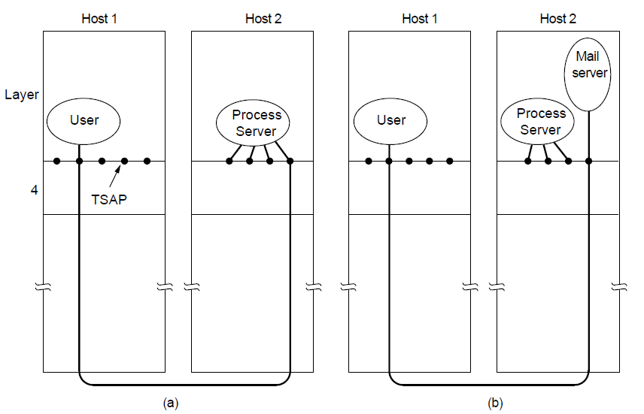
Addressing (3)
How a user process in host 1 establishes a connection
with a mail server in host 2 via a process server.

Slide 22
Connection Establishment (1)
If network is fully congested, neither data or ack are delivered, leading to multiple retransmissions.
If user crashes and start using the same set of sequence used earlier, it might lead to duplicate packet delivery problem
Fund transfer example
Solution can be –
  discard the port numbers used before crash
  Assign each connection unique number

Slide 23
Connection Establishment (1)
Techniques for restricting packet lifetime
Restricted network design.
Putting a hop counter in each packet.
Timestamping each packet.

Slide 24
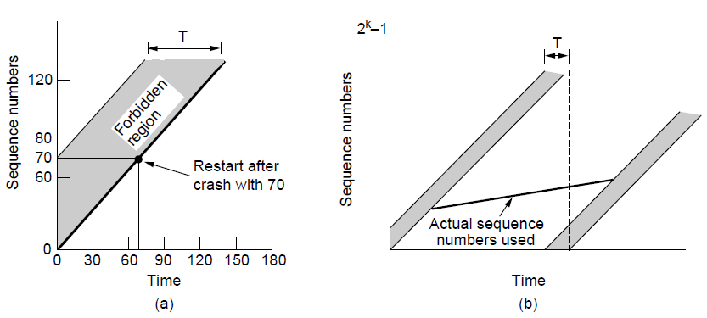
Connection Establishment (2)
* Forbidden region shows the times for which segment seq numbers are illegal
* If any segment is sent with a sequence number in this region, it could be delayed and impersonate a different packet with the same sequence number that will be issued slightly later
TPDUs may not enter the forbidden region.
The resynchronization problem.

Slide 25
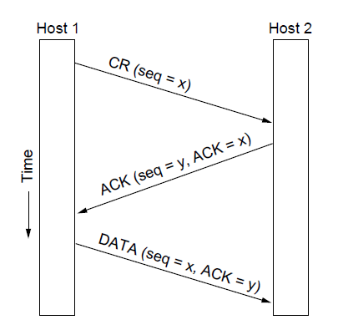
Connection Establishment (3)
Three protocol scenarios for establishing a connection using a
three-way handshake. CR denotes CONNECTION REQUEST. Normal operation.

Slide 26
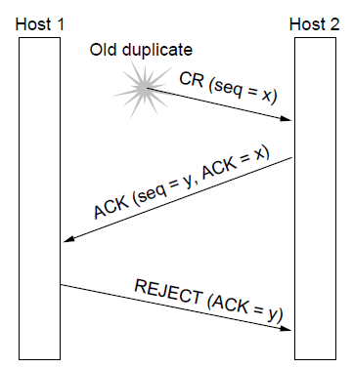
Connection Establishment (4)
Three protocol scenarios for establishing a connection using a
three-way handshake. CR denotes CONNECTION REQUEST. Old duplicate CONNECTION REQUEST appearing out of nowhere.

Slide 27
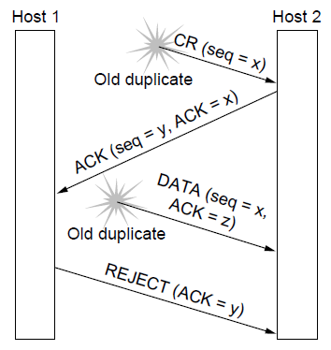
Connection Establishment (5)
Three protocol scenarios for establishing a connection using a
three-way handshake. CR denotes CONNECTION REQUEST. Duplicate CONNECTION REQUEST and duplicate ACK

Slide 28
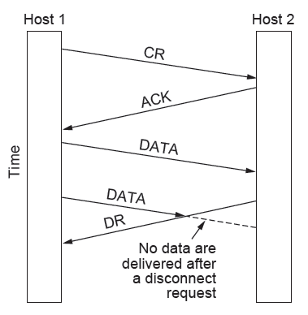
Connection Release (1)
Abrupt disconnection with loss of data

Slide 29
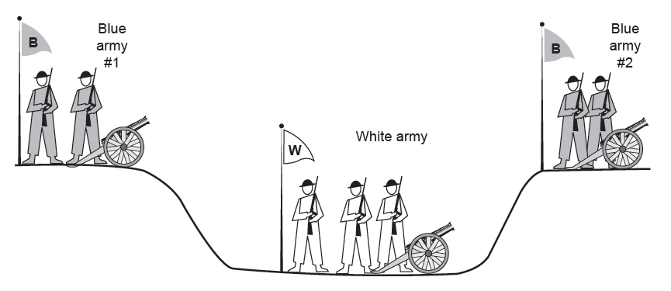
Connection Release (2)
The two-army problem

Slide 30
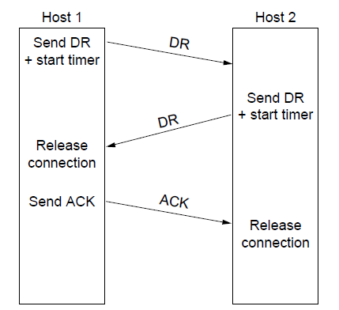
Connection Release (3)
Four protocol scenarios for releasing a connection.
(a) Normal case of three-way handshake

Slide 31
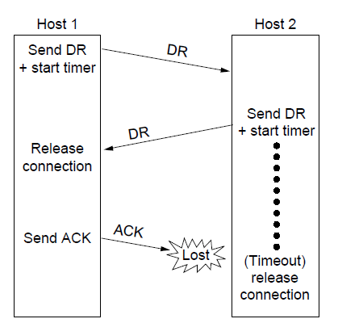
Connection Release (4)
Four protocol scenarios for releasing a connection.
(b) Final ACK lost.

Slide 32
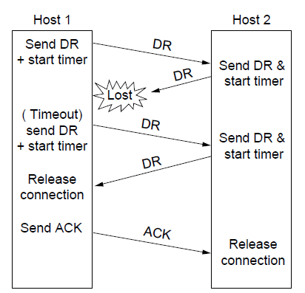
Connection Release (5)
Four protocol scenarios for releasing a connection.
(c) Response lost

Slide 33
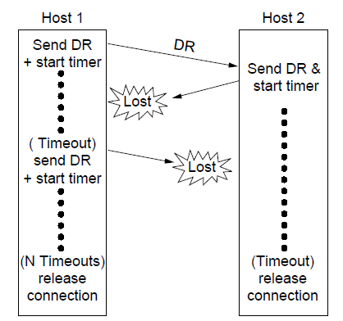
Connection Release (6)
Four protocol scenarios for releasing a connection.
(d) Response lost and subsequent DRs lost.

Slide 34
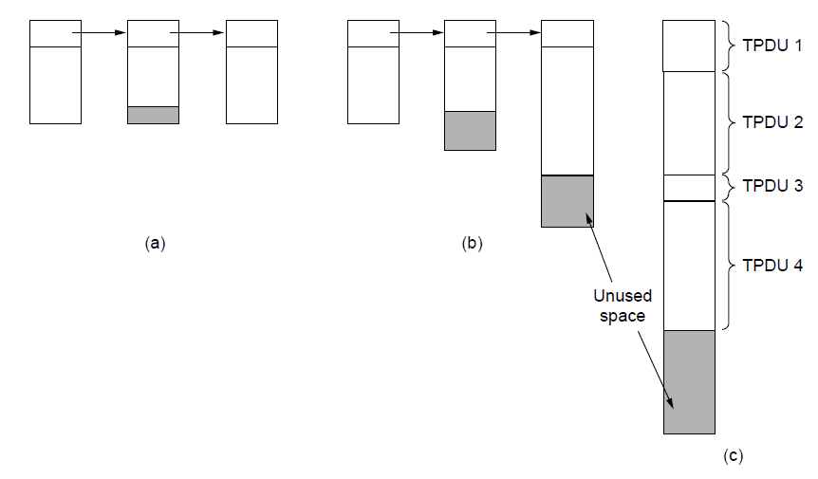
Error Control and Flow Control (1)
(a) Chained fixed-size buffers. (b) Chained variable-sized buffers. (c) One large circular buffer per connection.

Slide 35
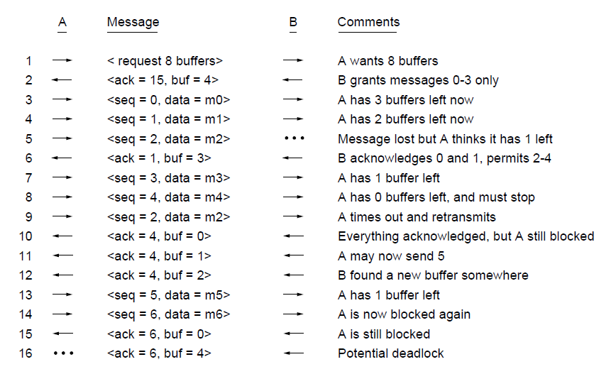
Error Control and Flow Control (2)
Dynamic buffer allocation. The arrows show the direction of transmission. An ellipsis (...) indicates a lost TPDU

Slide 36
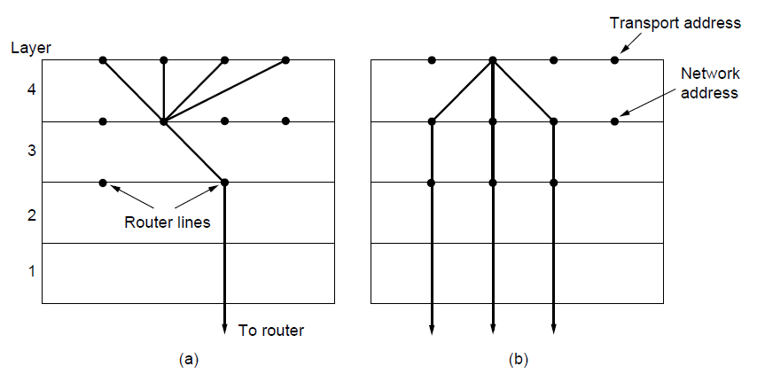
Multiplexing
(a) Multiplexing. (b) Inverse multiplexing.

Slide 37
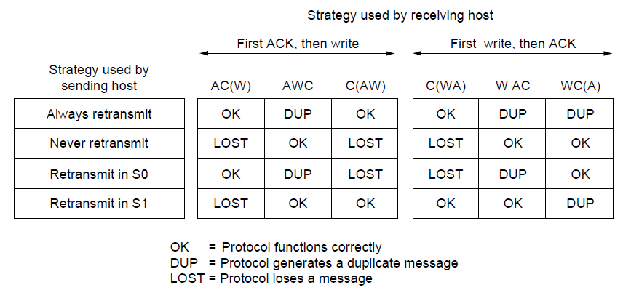
Crash Recovery
Different combinations of client and server strategy

Slide 38
Congestion Control
Desirable bandwidth allocation
Regulating the sending rate

Slide 39
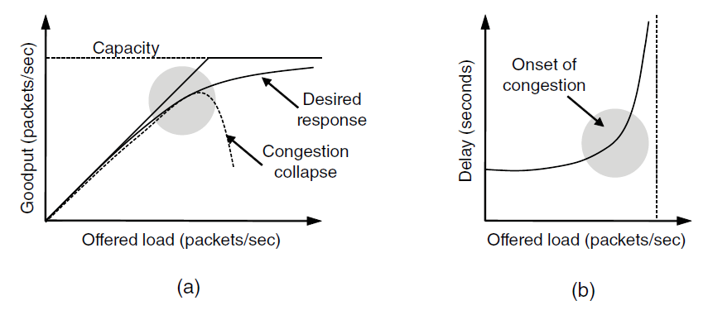
Desirable Bandwidth Allocation (1)
(a) Goodput and (b) delay as a function of offered load

Slide 40
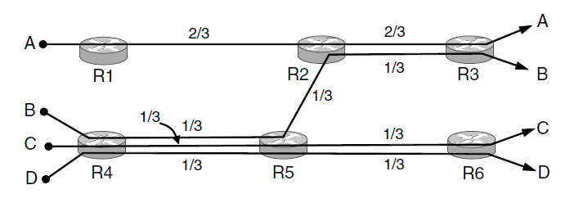
Desirable Bandwidth Allocation (2)
Max-min bandwidth allocation for four flows

Slide 41
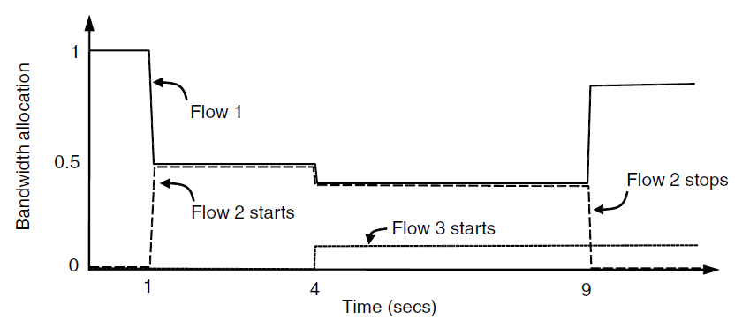
Desirable Bandwidth Allocation (3)
Changing bandwidth allocation over time

Slide 42
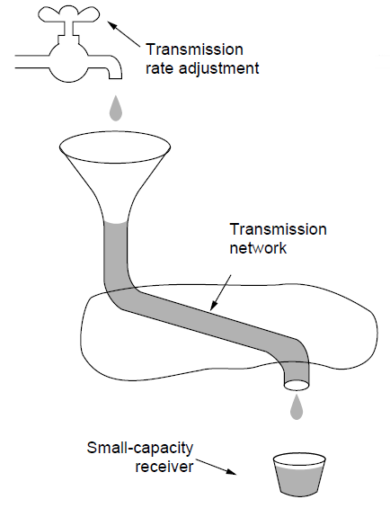
Regulating the Sending Rate (1)
A fast network feeding a low-capacity receiver

Slide 43
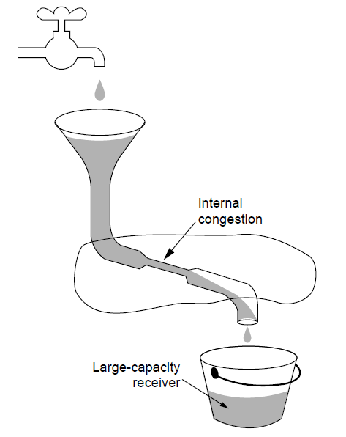
Regulating the Sending Rate (2)
A slow network feeding a high-capacity receiver

Slide 44
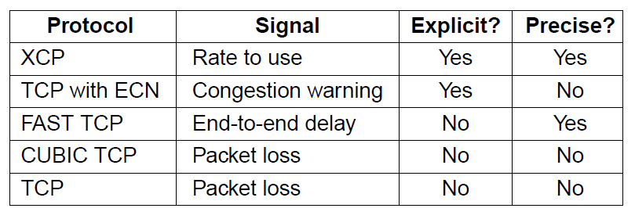
Regulating the Sending Rate (3)
Some congestion control protocols

Slide 45
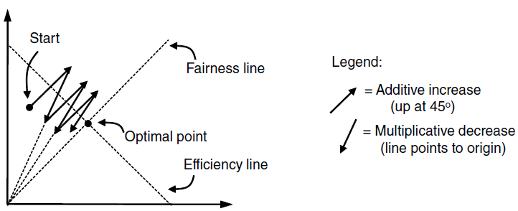
Regulating the Sending Rate (4)
User 2’s allocation
User 1’s allocation
Additive Increase Multiplicative Decrease (AIMD) control law.

Slide 46
The Internet Transport Protocols: UDP
Introduction to UDP
Remote Procedure Call
Real-Time Transport

Slide 47
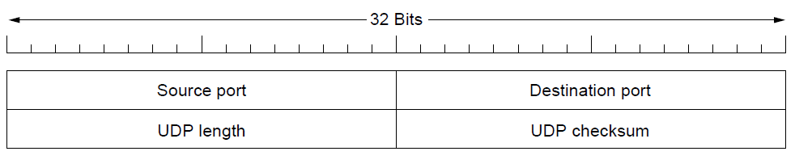
Introduction to UDP (1)
The UDP header.

Slide 48
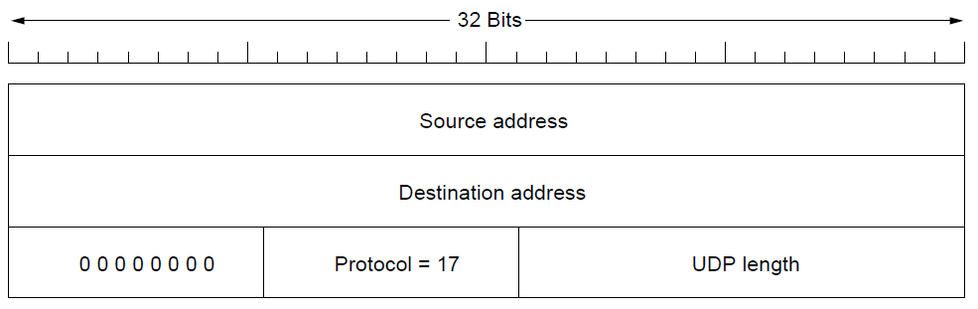
Introduction to UDP (2)
The IPv4 pseudoheader included in the UDP checksum.

Slide 49
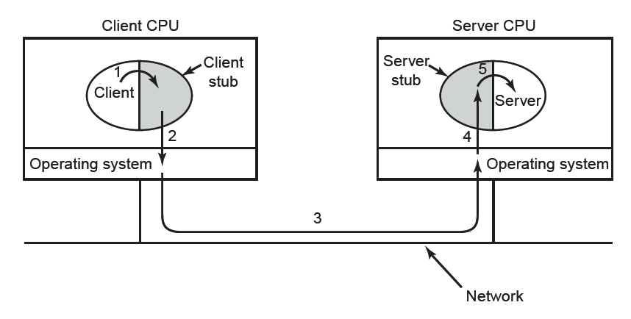
Remote Procedure Call
Steps in making a remote procedure call. The stubs are shaded.

Slide 50
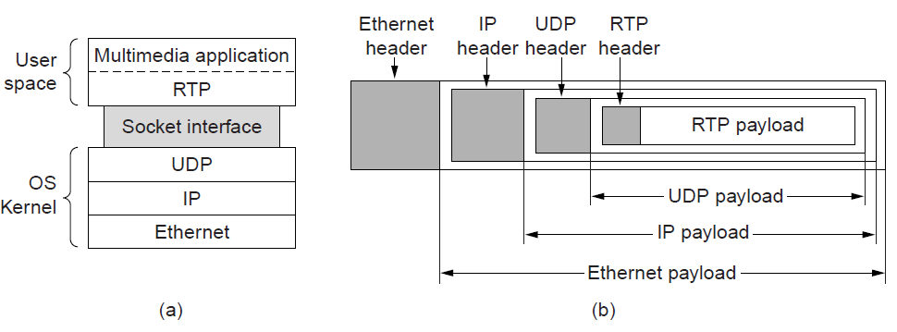
Real-Time Transport (1)
(a) The position of RTP in the protocol stack. (b) Packet nesting.

Slide 51
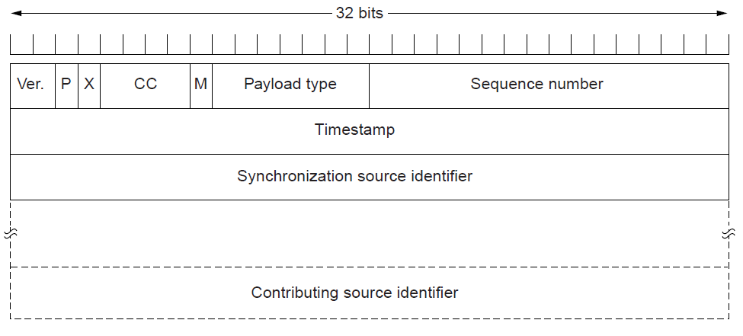
Real-Time Transport (2)
The RTP header

Slide 52
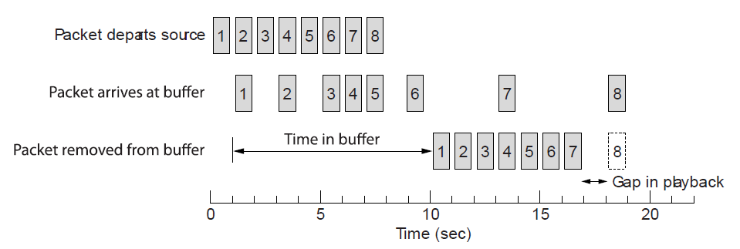
Real-Time Transport (3)
Smoothing the output stream by buffering packets

Slide 53
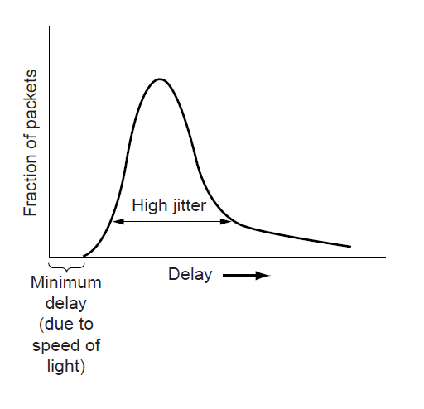
Real-Time Transport (3)
High jitter

Slide 54
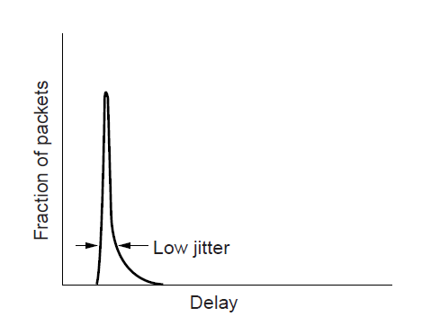
Real-Time Transport (4)
Low jitter

Slide 55
The Internet Transport Protocols: TCP (1)
Introduction to TCP
The TCP service model
The TCP protocol
The TCP segment header
TCP connection establishment
TCP connection release

Slide 56
The Internet Transport Protocols: TCP (2)
TCP connection management modeling
TCP sliding window
TCP timer management
TCP congestion control
TCP futures

Slide 57
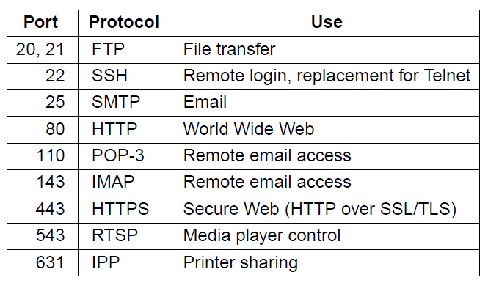
The TCP Service Model (1)
Some assigned ports

Slide 58
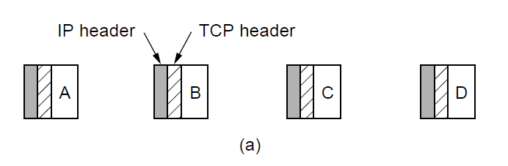
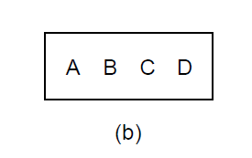
The TCP Service Model (2)
Four 512-byte segments sent as separate IP diagrams
The 2048 bytes of data delivered to the application in a single READ call

Slide 59
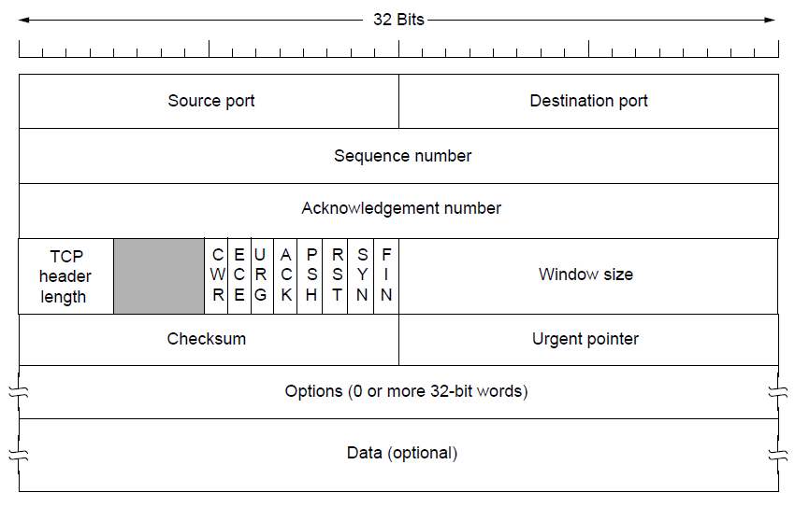
The TCP Segment Header
The TCP header.

Slide 60
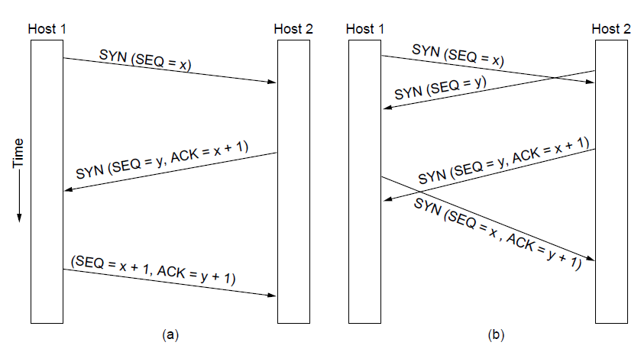
TCP Connection Establishment
TCP connection establishment in the normal case.
Simultaneous connection establishment on both sides.

Slide 61
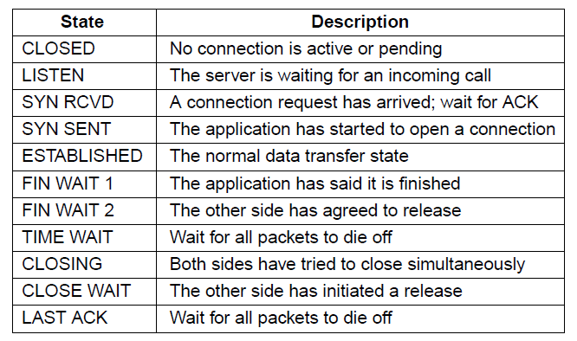
TCP Connection Management Modeling (1)
The states used in the TCP connection
management finite state machine.

Slide 62

TCP Connection Management Modeling (2)
TCP connection management finite state machine.
The heavy solid line is the normal path for a client. The heavy dashed line is the normal path for a server. The light lines are unusual events. Each transition is labeled by the event causing it and the action resulting from it, separated by a slash.

Slide 63

TCP Sliding Window (1)
Window management in TCP

Slide 64

TCP Sliding Window (2)
Silly window syndrome

Slide 65

TCP Timer Management
Probability density of acknowledgment arrival times in data link layer. (b) … for TCP

Slide 66

TCP Congestion Control (1)
Slow start from an initial congestion window of 1 segment

Slide 67

TCP Congestion Control (2)
Additive increase from an initial congestion
window of 1 segment.

Slide 68

TCP Congestion Control (3)
Slow start followed by additive increase in TCP Tahoe.

Slide 69

TCP Congestion Control (4)
Fast recovery and the sawtooth pattern of TCP Reno.

Slide 70
Performance Issues
Performance problems in computer networks
Network performance measurement
System design for better performance
Fast TPDU processing
Protocols for high-speed networks

Slide 71

Performance Problems in Computer Networks
The state of transmitting one megabit from San Diego to Boston. (a) At t = 0. (b) After 500 μ sec.
(c) After 20 msec. (d) After 40 msec.

Slide 72
Network Performance Measurement (1)
Steps to performance improvement
Measure relevant network parameters, performance.
Try to understand what is going on.
Change one parameter.

Slide 73
Network Performance Measurement (2)
Issues in measuring performance
Sufficient sample size
Representative samples
Clock accuracy
Measuring typical representative load
Beware of caching
Understand what you are measuring
Extrapolate with care

Slide 74

Network Performance Measurement (3)
Response as a function of load.

Slide 75
System Design for Better Performance (1)
Rules of thumb
CPU speed more important than network speed
Reduce packet count to reduce software overhead
Minimize data touching
Minimize context switches
Minimize copying
You can buy more bandwidth but not lower delay
Avoiding congestion is better than recovering from it
Avoid timeouts

Slide 76

System Design for Better Performance (2)
Four context switches to handle one packet
with a user-space network manager.

Slide 77

Fast TPDU Processing (1)
The fast path from sender to receiver is shown with a heavy line. The processing steps on this path are shaded.

Slide 78

Fast TPDU Processing (2)
(a) TCP header. (b) IP header. In both cases, the shaded fields are taken from the prototype without change.

Slide 79

Protocols for High-Speed Networks (1)
A timing wheel

Slide 80

Protocols for High-Speed Networks (2)
Time to transfer and acknowledge a
1-megabit file over a 4000-km line

Slide 81
Delay Tolerant Networking
DTN Architecture
The Bundle Protocol

Slide 82

DTN Architecture (1)
Delay-tolerant networking architecture

Slide 83

DTN Architecture (2)
Use of a DTN in space.

Slide 84

The Bundle Protocol (1)
Delay-tolerant networking protocol stack.

Slide 85

The Bundle Protocol (2)
Bundle protocol message format.

Slide 86
End
Chapter 6

